Slide 1
Product-Led Growth

Slide 2
Innovatemap is a digital product agency.
We help companies of all sizes dream, design, and deliver to market winning digital products and services.

Slide 3

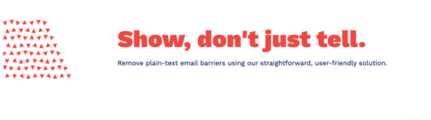
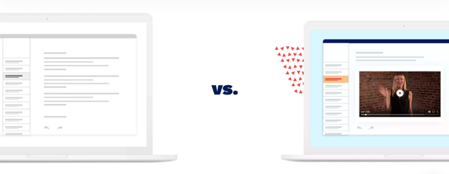
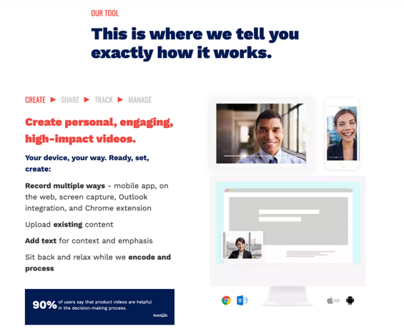
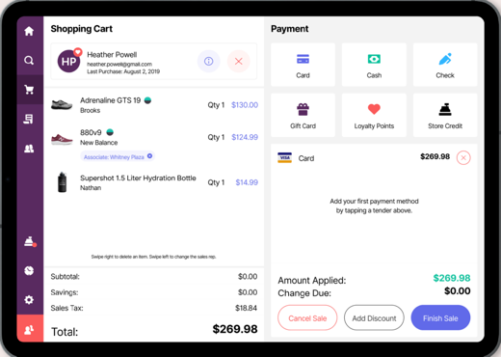
Better product is marketable, valuable, and usable.
Our team of product professionals partners with clients to amplify what’s working and fix what’s not, by specializing in four key disciplines:
Product Management
What to build, when, why, and how.
Product Design
User experiences, beautiful and intuitive.
Product Brand
Visual identity and a story worth telling.
Product Marketing
Messaging, positioning, and tools for growth.

Slide 4
Product-Led Growth Foundation:
What is PLG?
How does it work?
What does it mean for the organization?

Slide 5
What is Product-Led Growth?
Notes:
This is a phrase that’s starting to be thrown around a lot, and like any new concept it encompasses some new and some old.
Some things to think about:
What of this are you already doing today?
Where do you see possible impacts on your teams?
Where do you have questions for how this would work in your market or industry?

Slide 6
Product-Led Growth (PLG) is a go-to-market strategy that relies on product usage as the primary driver of acquisition, conversion and expansion.
Blake Bartlett, Partner
https://openviewpartners.com/product-led-growth/#.Xlgl_BNKg6U
Notes:
OpenView is a venture capital firm that really coined the term “product-led growth” and is putting out some great thought leadership on the subject. We like to use their definition when thinking about PLG.
We’re going to spend some time talking about those 3 phases – so what do we mean by them?

Slide 7
Product-Led Growth (PLG) is a go-to-market strategy that relies on product usage as the primary driver of acquisition, conversion and expansion.
How to acquire
new prospects

Slide 8
Product-Led Growth (PLG) is a go-to-market strategy that relies on product usage as the primary driver of acquisition, conversion and expansion.
How to get new prospects to become paying customers

Slide 9
Product-Led Growth (PLG) is a go-to-market strategy that relies on product usage as the primary driver of acquisition, conversion and expansion.
How to get paying customers to upgrade and add more users

Slide 10
Acquisition, conversion and expansion used to happen via marketing and sales teams.
Today, they’re happening through the product.
How did we get here?

Slide 11
The Old Days
Software was the realm of IT
Delivery meant on-premise software
Big money to build, implement, train, maintain

Slide 12
The Old Days
Acquisition, Conversion, and Expansion all happening at the highest levels
Sales team interacting with highest level at a company
C-Suite
Expensive, difficult implementation
Static documentation & training
IT Department
Lengthy upgrade processes
End Users

Slide 13
What’s happened since?

Slide 14
What’s happened since?
Rise of cloud computing
SaaS delivery model
Subscription business model
Integrations became commonplace
Elastic infrastructure and performance capabilities
Spread of the internet into common communications
Search engines
Things changed,
which made some things obsolete,
and gave rise to new opportunities.

Slide 15
What’s happened since?
Rigid internal infrastructure
Software on discs
Long and expensive implementations
Upgrades
“All-in-one” solutions
Lengthy training classes
Extensive static documentation
Things changed,
which made some things obsolete,
and gave rise to new opportunities.

Slide 16
What’s happened since?
Flexible cloud architectures
Internet as a delivery mechanism
Flexible subscription packages from very low to very high usage
Best-of-class solutions
Marketing to all levels of an organization
Easy access to training, help, how-to’s
Things changed,
which made some things obsolete,
and gave rise to new opportunities.
Notes:
If software is everywhere and we’re using it for everything AND software companies have access to reach ALL levels of a company easily through marketing and implementation, in Search Engines and Facebook ads, then they don’t have to just talk to the CEO, they can talk to the End User.

Slide 17
The New Days
Everyone uses software for everything.
Delivery is instant.
Cheaper to build, implement, train, maintain.
Notes:
If software is everywhere and we’re using it for everything AND software companies have access to reach ALL levels of a company easily through marketing and implementation, then they don’t have to just talk to the CEO, they can talk to the End User.

Slide 18
The New Days
Acquisition, Conversion, and Expansion is in the hands of end-users
End-users experiencing a problem Google it, find a solution, try it out on their own
End Users
If they are convinced there’s value, the end user can pay for a low-tier package
To get more value, the end user can invite others, upgrade to unlock more features and allow for more users
IT
C-Suite

Slide 19
What Product-Led Growth Means

Slide 20
Creating growth through features that enable self-service everything.
For example:
Education
Trial
Sign-up
Implementation
Billing
Sharing
Upselling
Renewal

Slide 21
How does PLG work?
Notes:
PLG

Slide 22
Acquisition → Conversion → Expansion

Slide 23
Acquisition → Conversion → Expansion
Acquisition is people being aware of your product, having a way to experience your product,
and having a reason to come back.

Slide 24
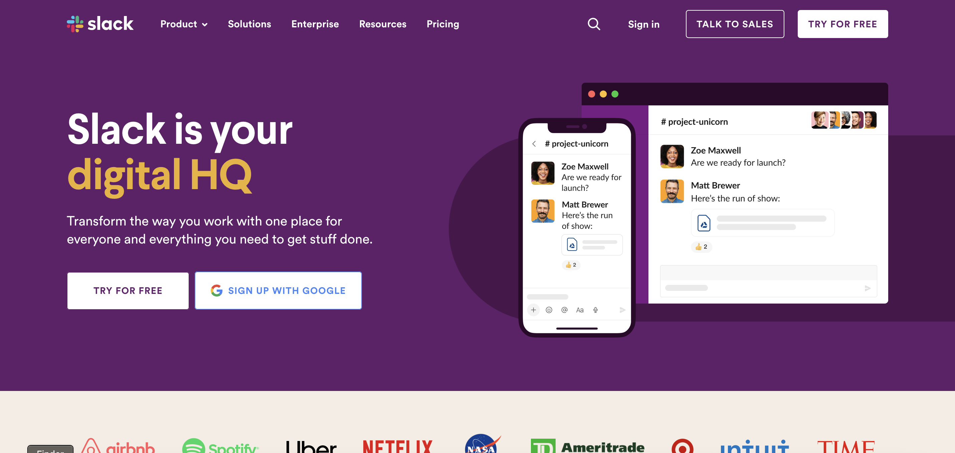
Acquisition → Conversion → Expansion
People being aware of your product = Brand + Marketing
Notes:
When you don’t have salespeople doing the explaining for you, brand has to do a lot more work.
If someone is finding you from a google search- Your name, visual identity, tone of voice are your front doors to people understanding what you’re all about
They also become something of a differentiator – even if someone copies your features, your brand will still be uniquely yours
** And incidentally, Customer Success is also part of that brand
The example we’re showing here is Slack – the messaging is clear, I get what they’re going to do for me, and the look and feel are polished and friendly; If you compare this to traditional Microsoft, Oracle, IBM brands, the difference is striking – Those brands didn’t need to do as much work – they only had to look solid to an upper echelon of management. Slack, Lessonly, Zylo – these brands are relating to a much wider audience.

Slide 25
Acquisition → Conversion → Expansion
Is your product approachable?
Does it have a recognizable identity and voice?
Does the experience feel right for your target audience?
Notes:
Is your product approachable?
Does it have a recognizable identity and voice?
Does the experience feel right for your target audience?

Slide 26


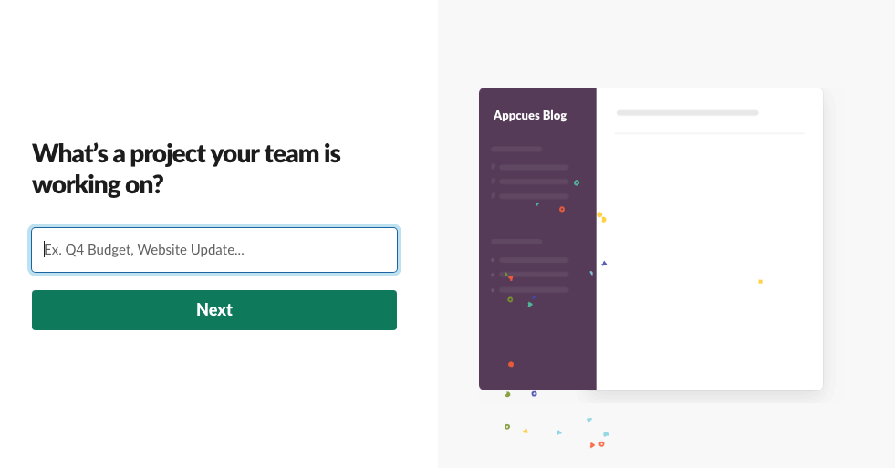
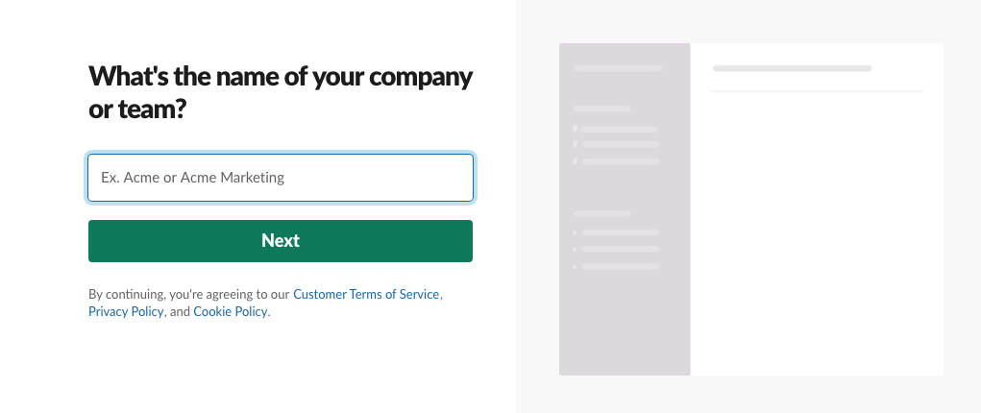
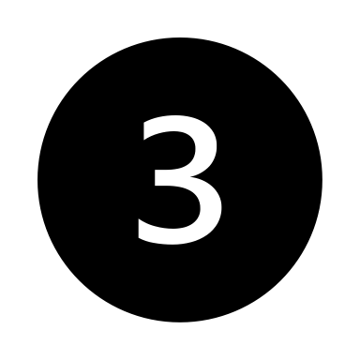
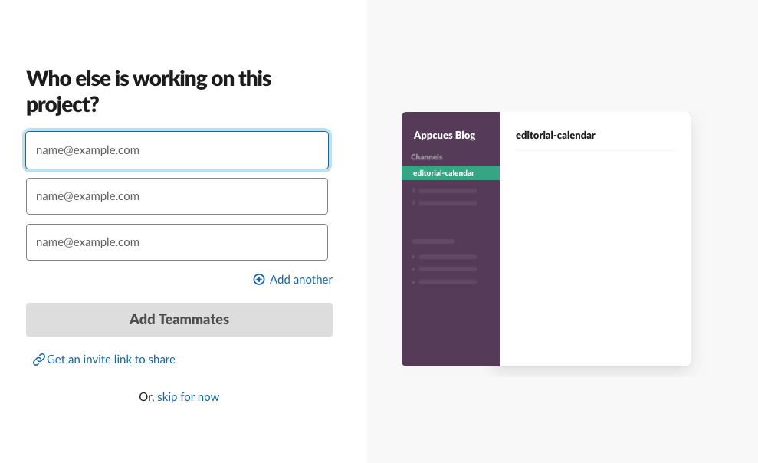

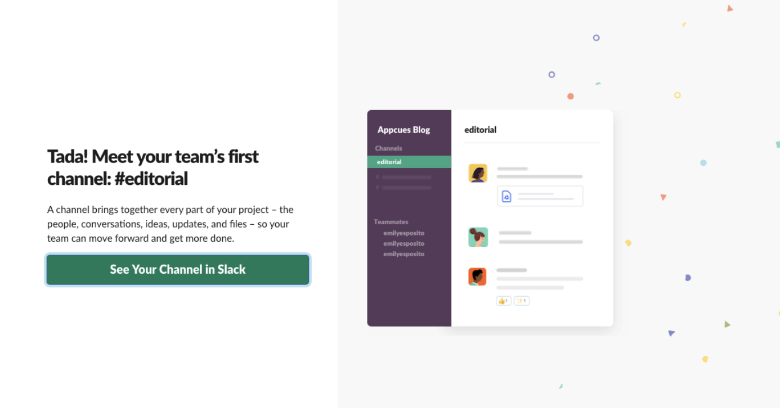
Acquisition → Conversion → Expansion
Having a way to experience your product = First-time UX
Notes:
Having a way to experience your product: That means have a great first-time user experience, what we could also call onboarding
Users need to be able to understand how to unlock value as quickly as possible
They need to feel freedom and safety to explore and unlock the aha moments that tell them why they need to use your software
In this example for Slack – you can see that I’m being welcomed multiple ways and given some options for how to learn more and take actions.
They’re using a “tour”, but they’re also using the product itself to onboard me with these slackbot messages. I’m being invited AND educated at the same time by the product in a safe and personable way to try it out.
We all just want to feel smart and understood – good onboarding can do that for users

Slide 27
Acquisition → Conversion → Expansion
Does your target audience have a way to give your product a chance?
Do they have a way to experience the key value prop?
Notes:
Does your target audience have a way to give your product a chance?
Do they have a way to experience the key value proposition?

Slide 28
Acquisition → Conversion → Expansion
Having a reason to come back = Value + UX + Marketing
Notes:
Having a reason to come back – it’s not enough for a user to come once, check you out and then leave
Have you given them a reason to return?
For Slack, I might come back if I get a notification that someone I invited sent me a message. Or I might come back if I get this email showing me different ways I can use Slack – Assign tasks?
A lot of times we give users a bunch of tools and then expect them to use their imaginations to figure out what to do with them, so the more you can present them with use cases and case studies and examples, the more you start turning on their light bulbs.

Slide 29
Acquisition → Conversion → Expansion
Do people have a reason to come back?
Are you solving a specific problem or providing new value?
Are people in the marketing drip?
Notes:
Do people have a reason to come back?
Are you solving a specific problem or providing new value?
Are people in the marketing drip?

Slide 30
Acquisition → Conversion → Expansion
Acquisition Key Takeaways
When the product’s job is to draw people in:
Brand identity must be powerful enough to speak for itself.
The value prop must be obvious and available to be experienced.
The experience must be intuitive, uncomplicated, empathetic, and even enjoyable.
Marketing has a powerful place in educating, positioning, reminding, and capitalizing on the leads the product qualifies.

Slide 31
Acquisition → Conversion → Expansion

Slide 32
Acquisition → Conversion → Expansion
Conversion is turning a prospective user into a user, and a user into a paying user. Providing the right value proposition, the ability to inform themselves, and a way to start paying.

Slide 33
Acquisition → Conversion → Expansion
Start with delivering value…
Freemium
Some functionality
is free forever
Great when more users is more important than paying users
Free Trial
All functionality
is free for a short time
Great when getting the right users is more important than getting lots of users
Build A Fan Base
Hook users on content
and expertise
Great when price and level of effort to engage are high
Notes:
- Free trial for premium features
- Let's talk through some examples

Slide 34
Acquisition → Conversion → Expansion
Start with delivering value…
Freemium
Free Trial
Build A Fan Base
Notes:
- Free trial for premium features
- Let's talk through some examples

Slide 35
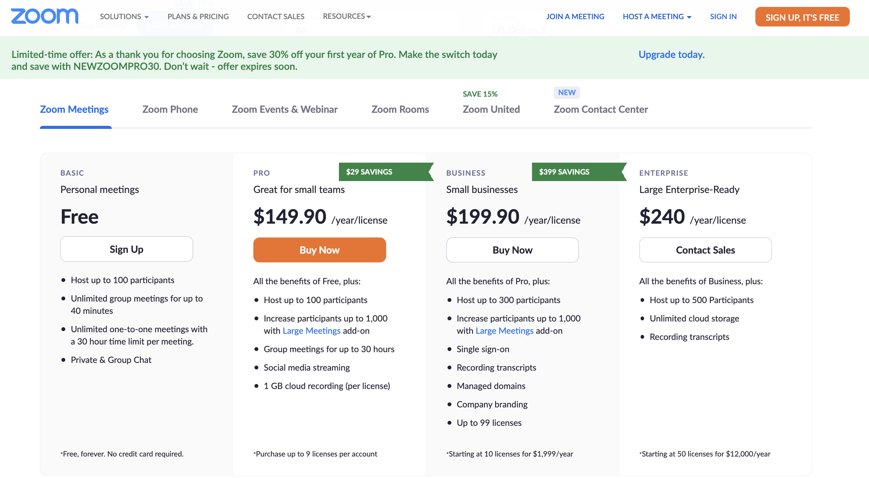
Acquisition → Conversion → Expansion
Start with delivering value…
Freemium
Free Trial
Build A Fan Base
Notes:
- Free trial for premium features
- Let's talk through some examples

Slide 36

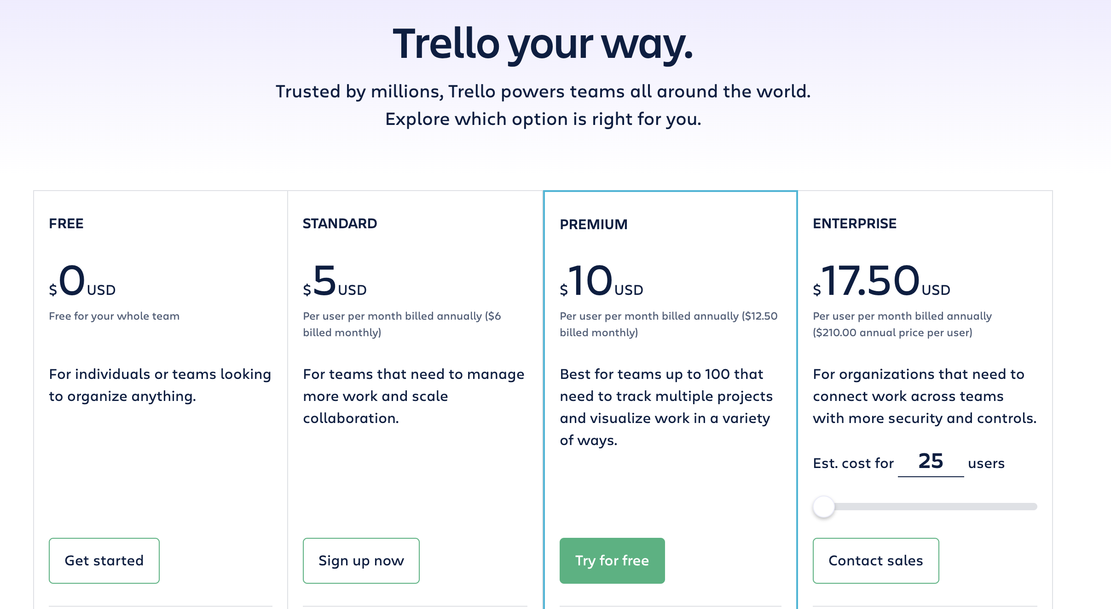
Acquisition → Conversion → Expansion
Start with delivering value…
Freemium
Free Trial
Build A Fan Base
Notes:
- Free trial for premium features
- Let's talk through some examples

Slide 37
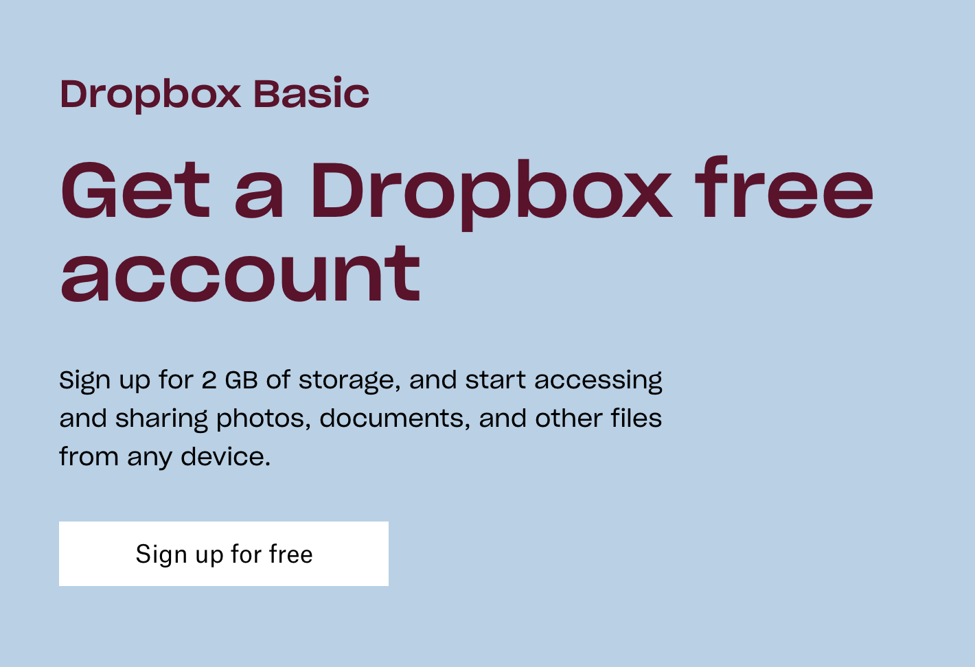
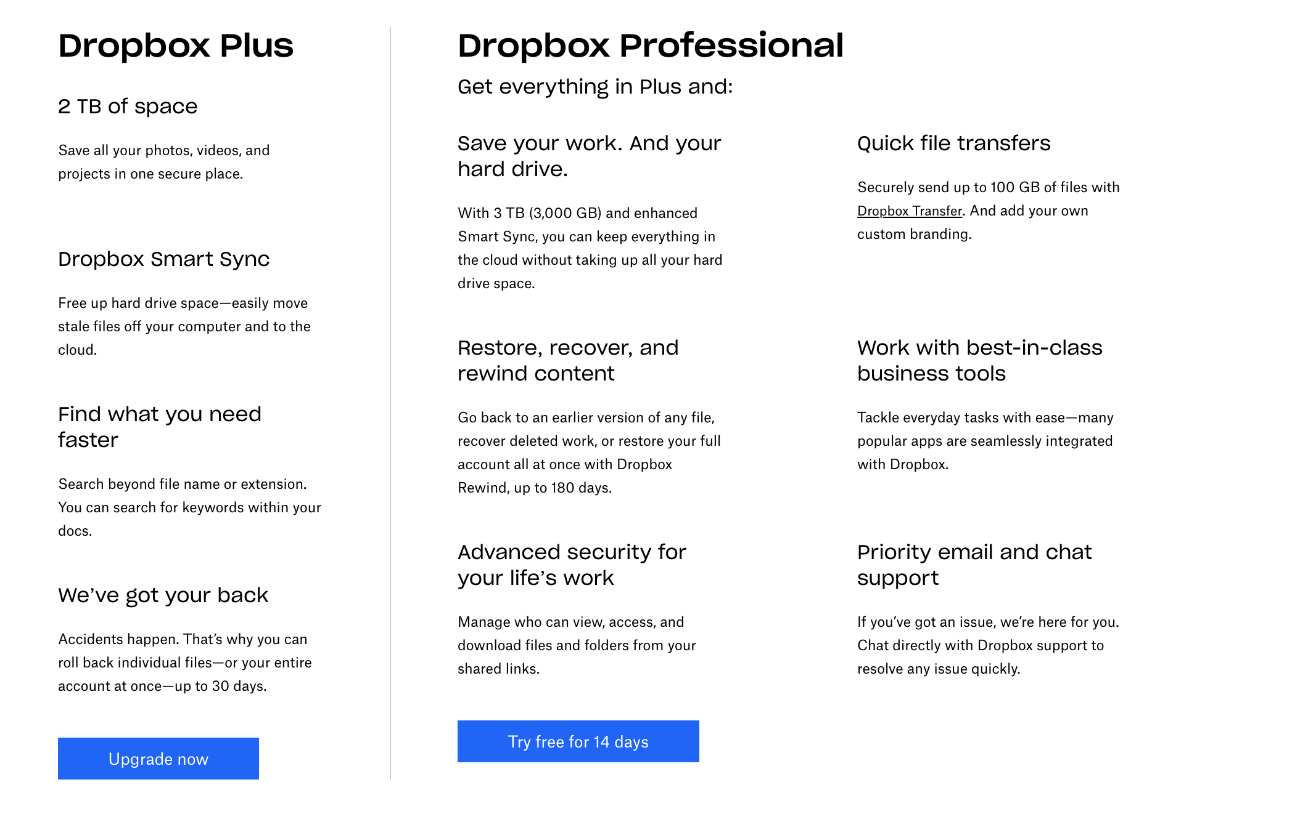
Acquisition → Conversion → Expansion
Start with delivering value…
Freemium
Free Trial
Build A Fan Base
Notes:
- Free trial for premium features
- Let's talk through some examples

Slide 38
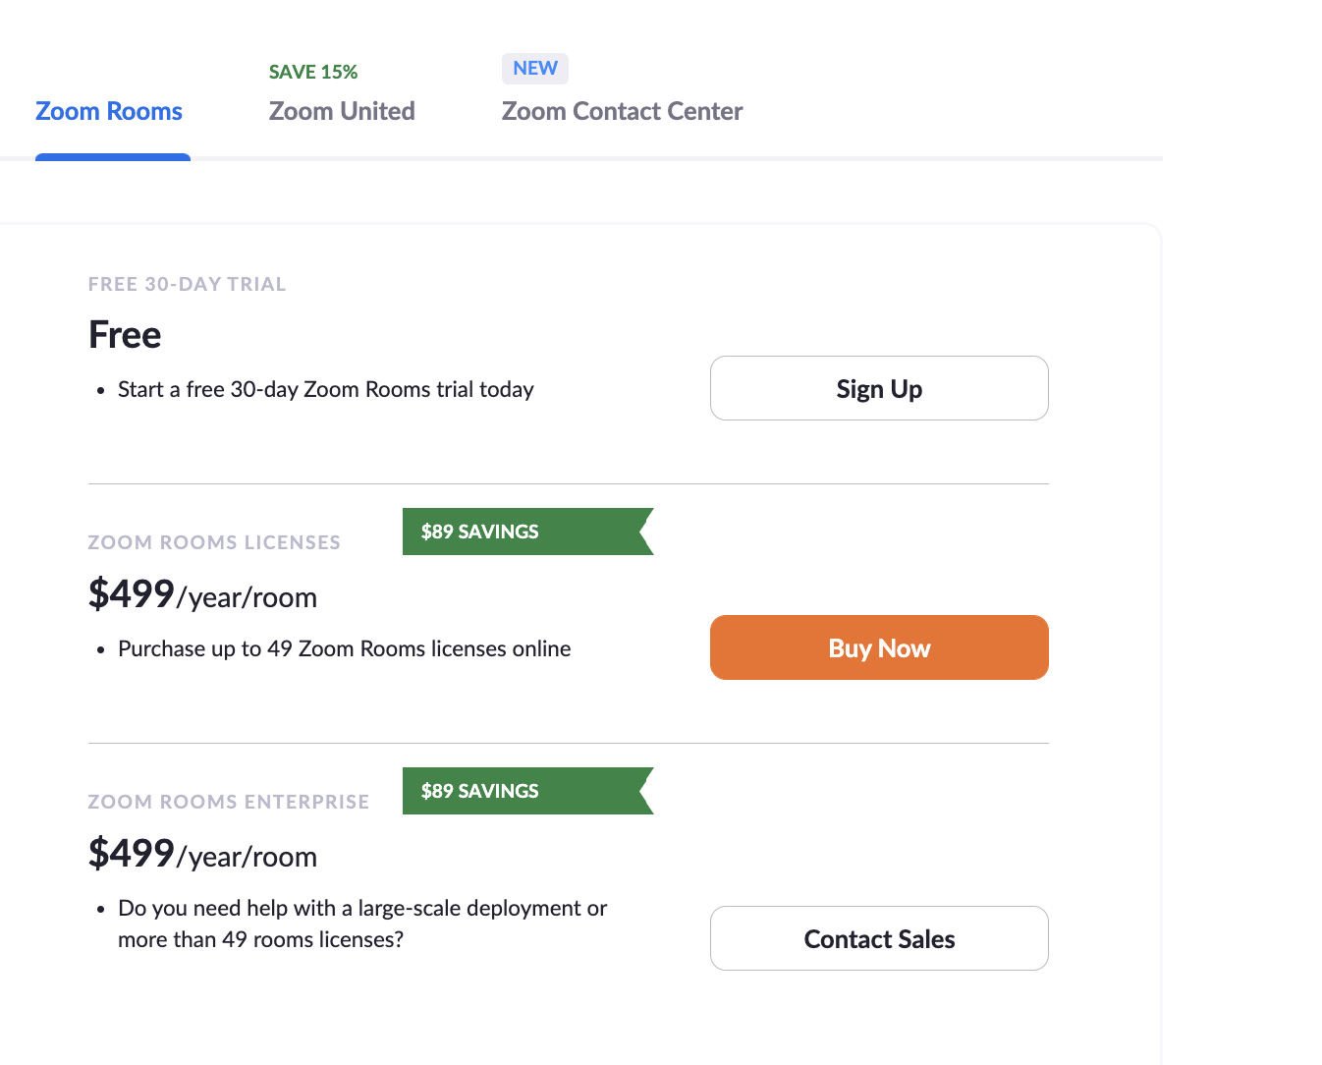
Acquisition → Conversion → Expansion
Start with delivering value…
Freemium
Free Trial
Build A Fan Base
Notes:
- Free trial for premium features
- Let's talk through some examples

Slide 39
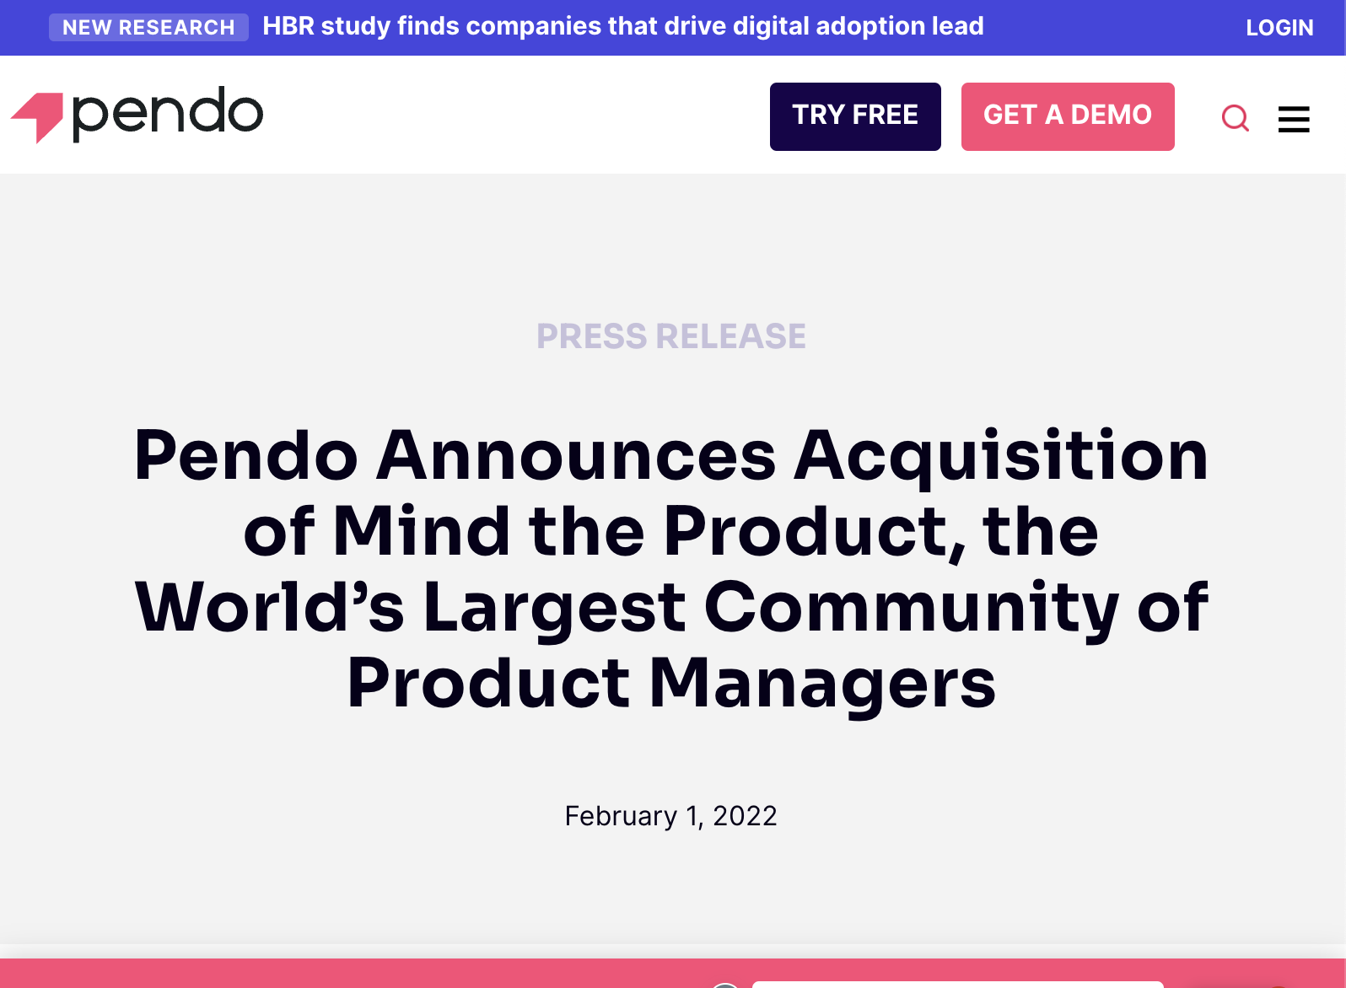
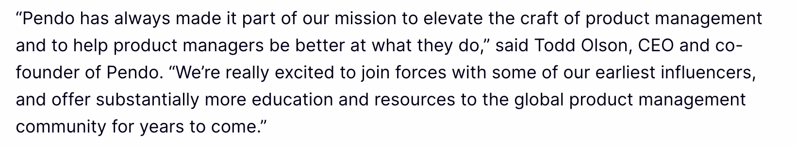
Acquisition → Conversion → Expansion
Start with delivering value…
Freemium
Free Trial
Build A Fan Base
Notes:
- Free trial for premium features
- Let's talk through some examples

Slide 40
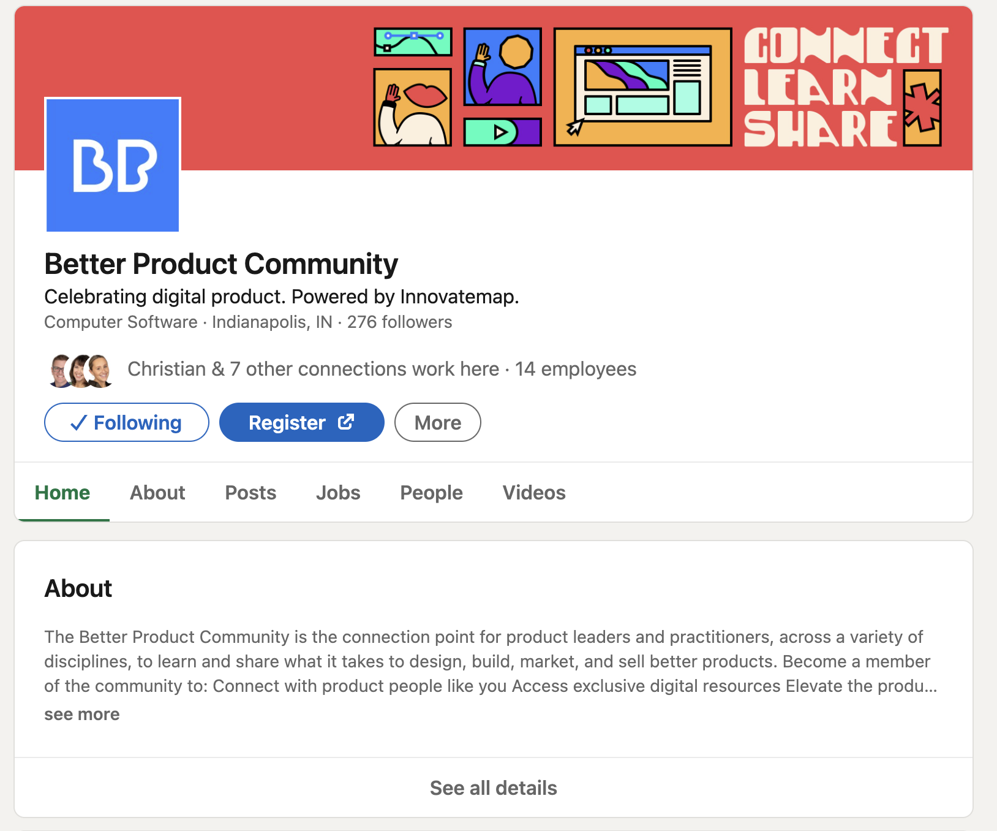
Acquisition → Conversion → Expansion
Start with delivering value…
Freemium
Free Trial
Build A Fan Base
Notes:
- Free trial for premium features
- Let's talk through some examples

Slide 41
Acquisition → Conversion → Expansion

Slide 42
Acquisition → Conversion → Expansion
Expansion is turning your users into a marketing channel, while growing your user base, and upselling within that user base.

Slide 43
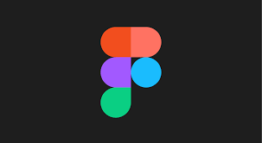
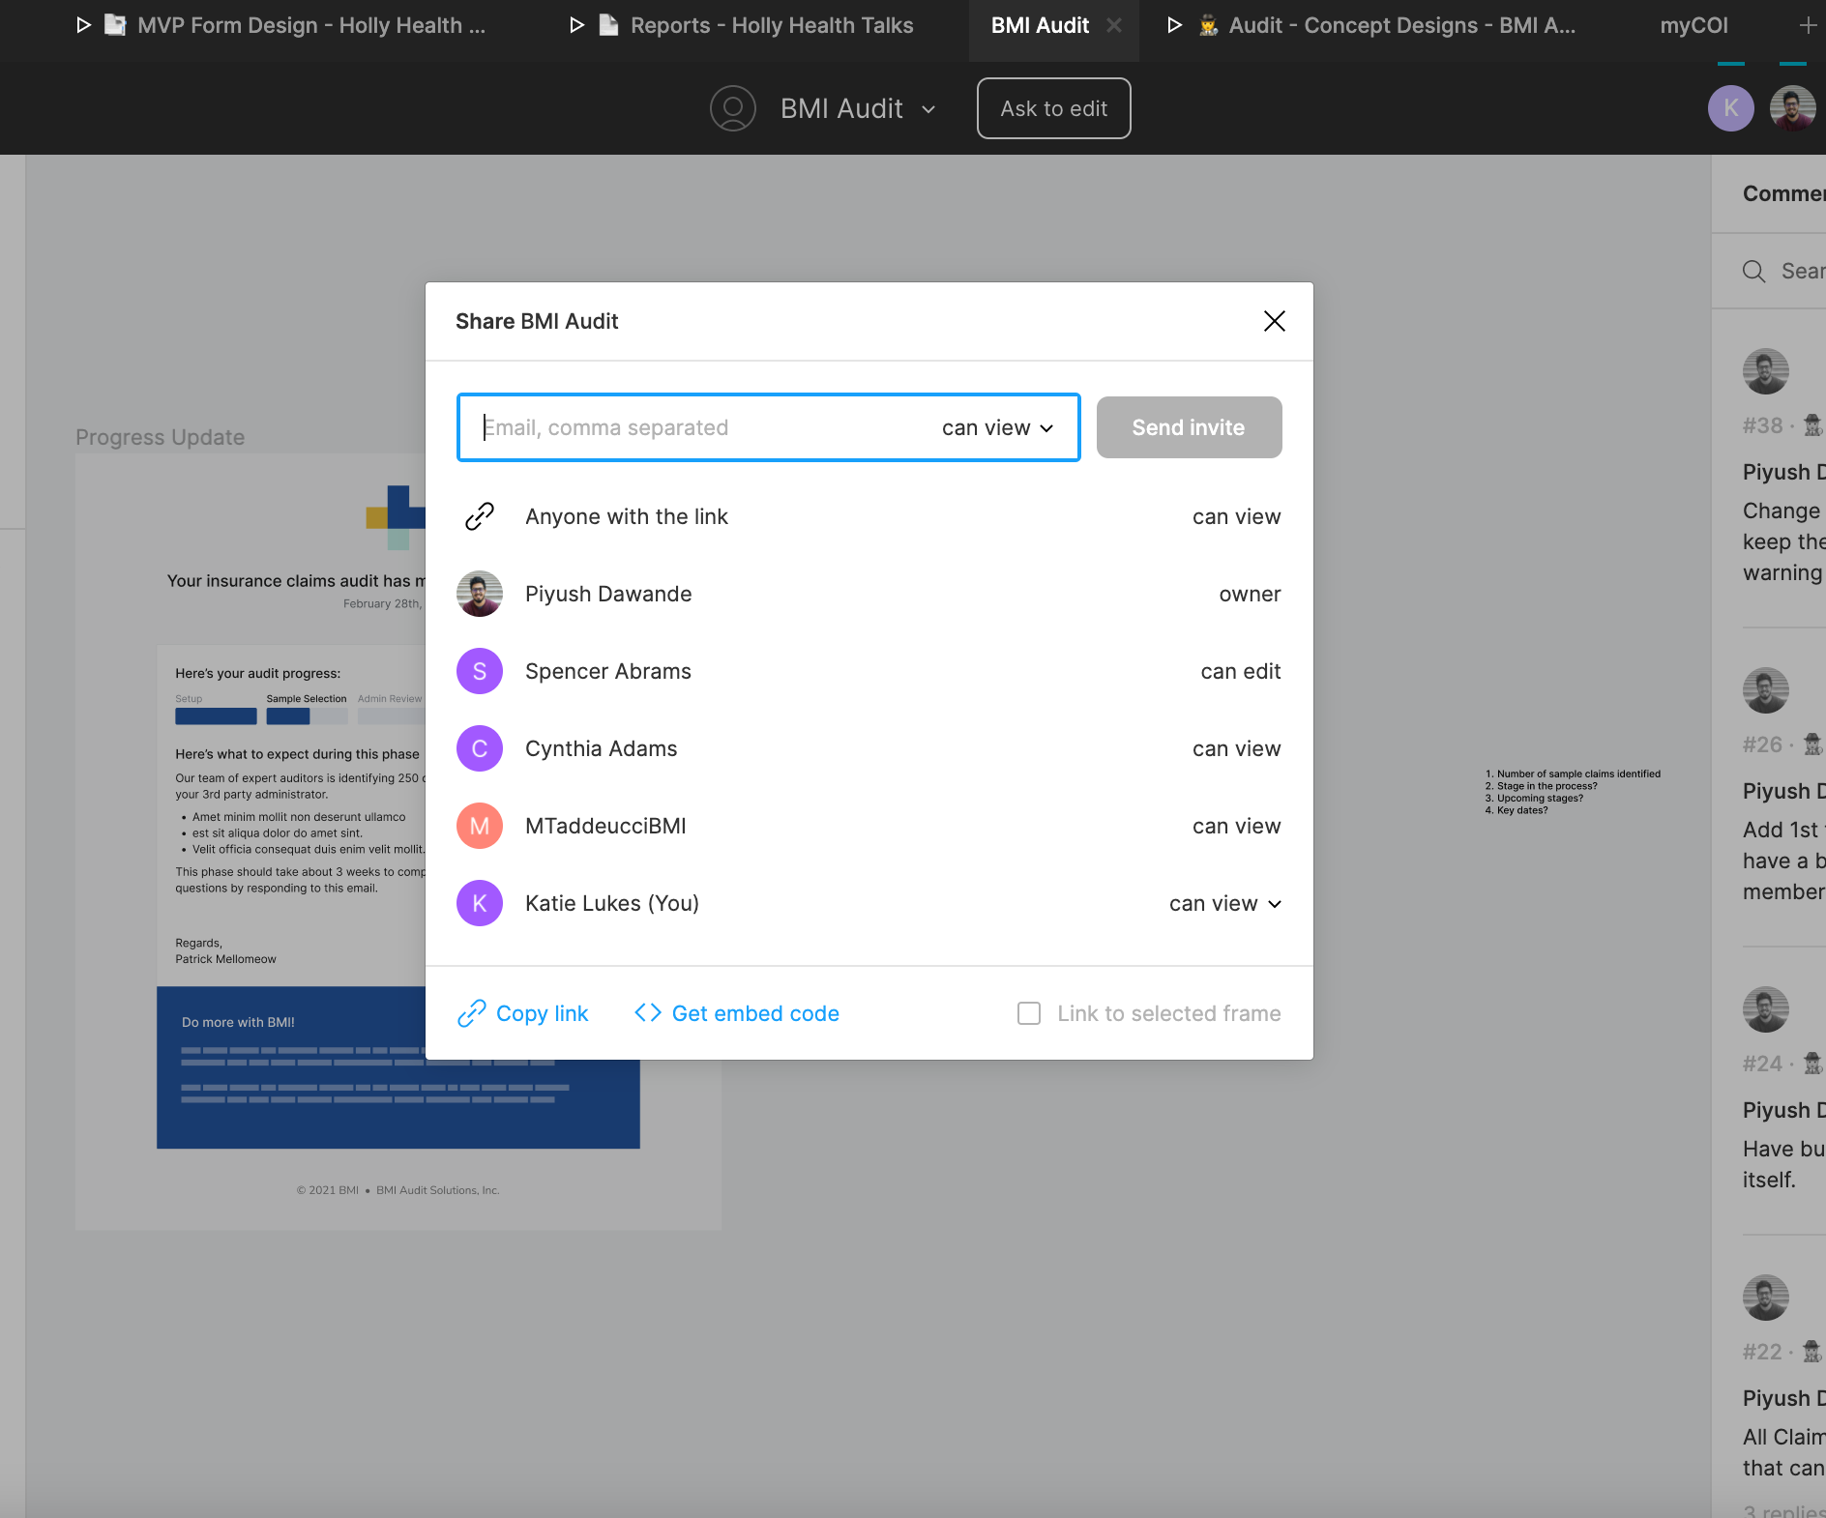
Acquisition → Conversion → Expansion
Build it Into the Product
Easy to Share
Just-In-Time Upgrading
Incentivize Invites
Branded Experiences
Notes:
A lot of you have received invitations like this from us – Invision makes it as easy as possible to share
And you’ve seen the proliferation of the Share button – some of that is for your benefit as a user, but a lot of that is for the benefit of the product. Your share means their brand and functionality reaches more people.

Slide 44
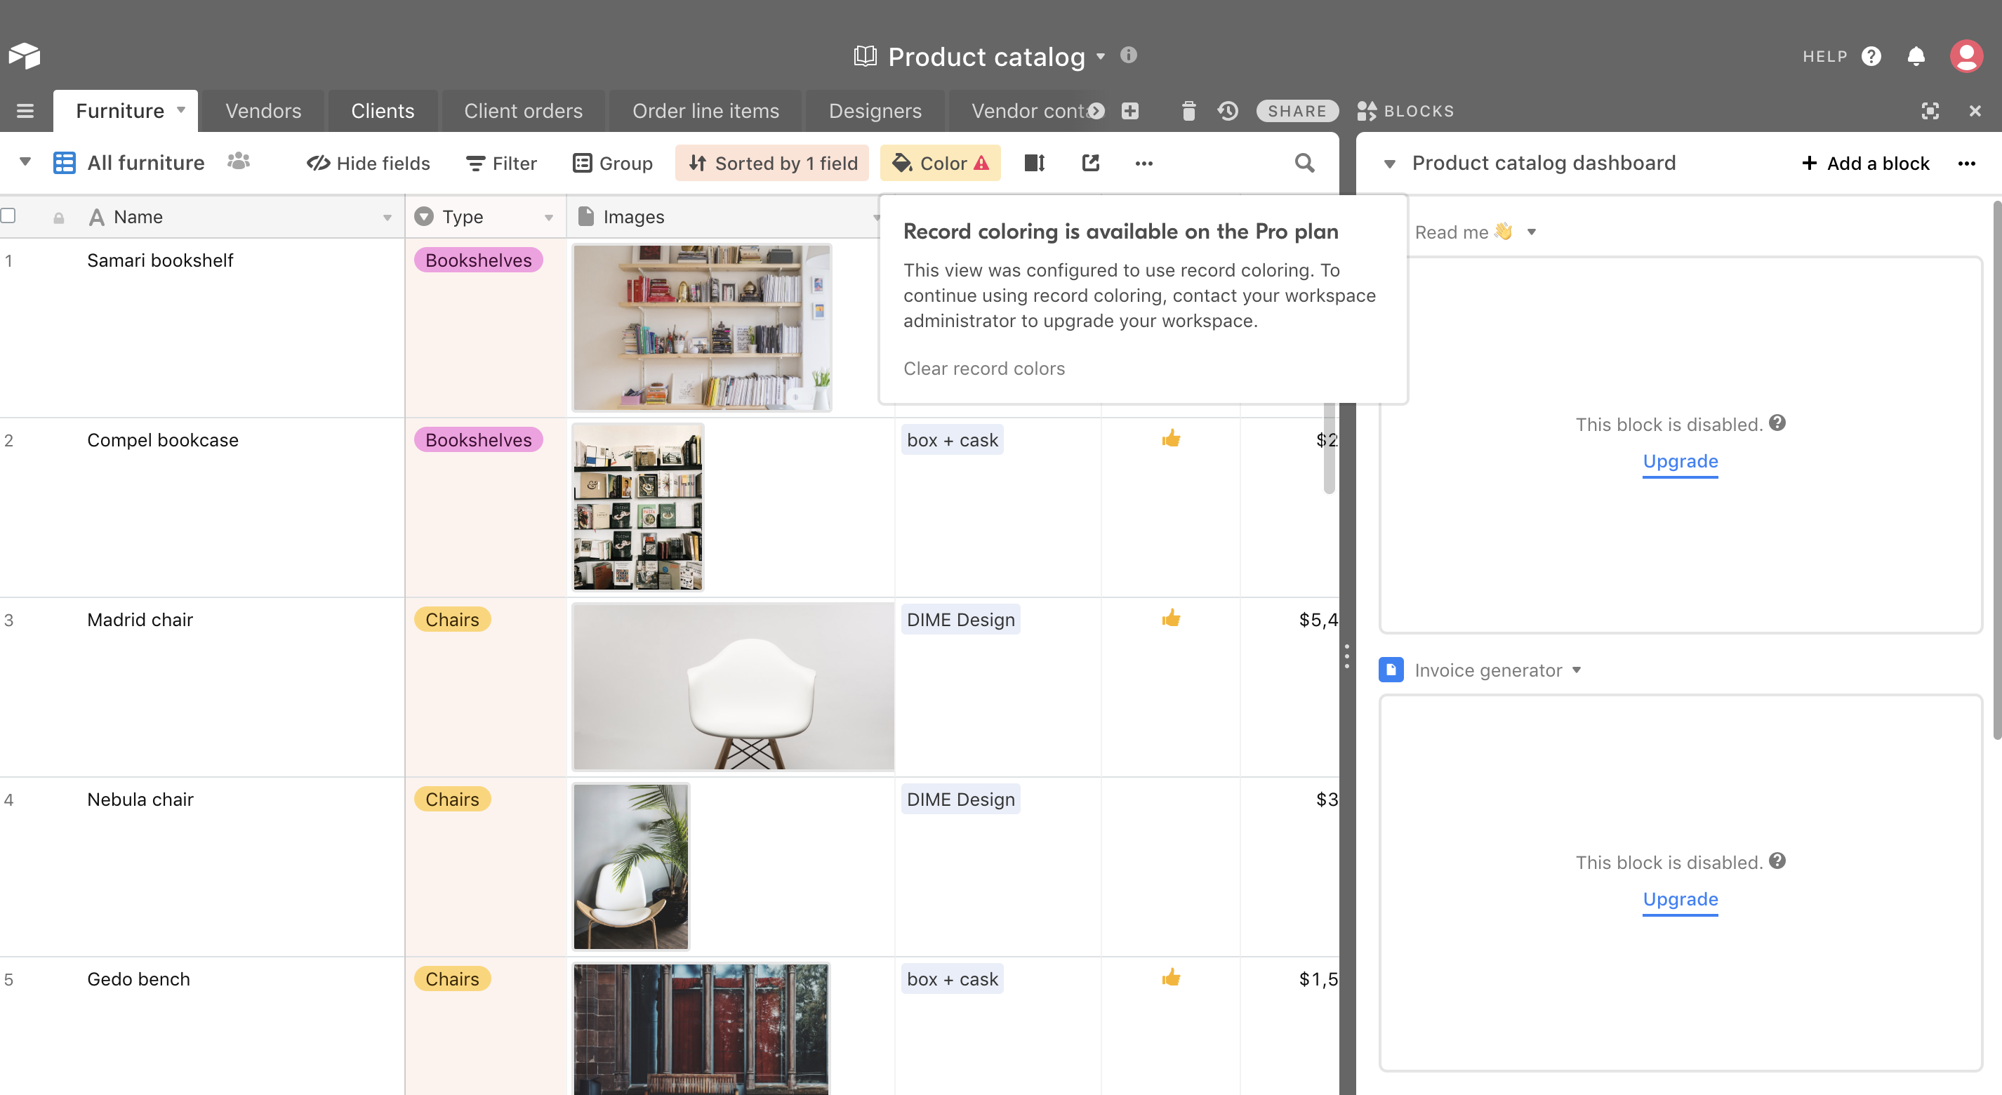
Acquisition → Conversion → Expansion
Build it Into the Product
Easy to Share
Just-In-Time Upgrading
Incentivize Invites
Branded Experiences
Notes:
Give the people a way to upgrade!
A lot of times users want to use more functionality but if it’s hidden away, they won’t know what is available to them
Our example here is Airtable – They sprinkle opportunities to upgrade throughout the product in more than one place.
in context!!

Slide 45
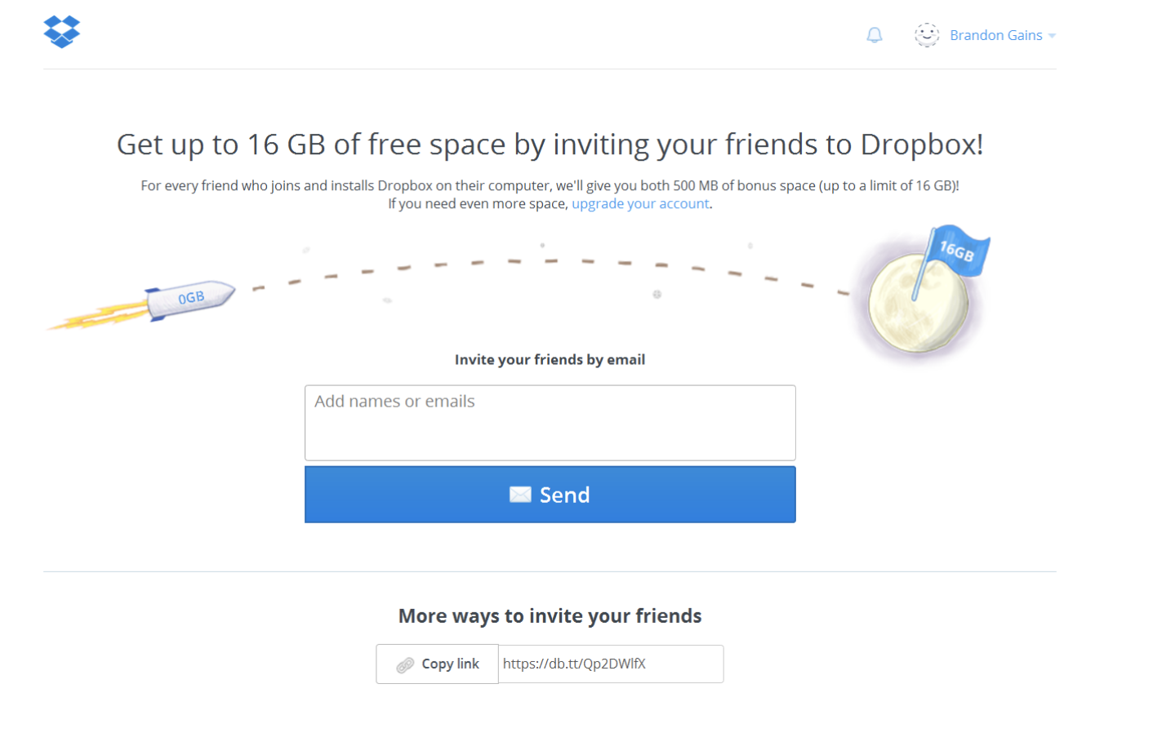
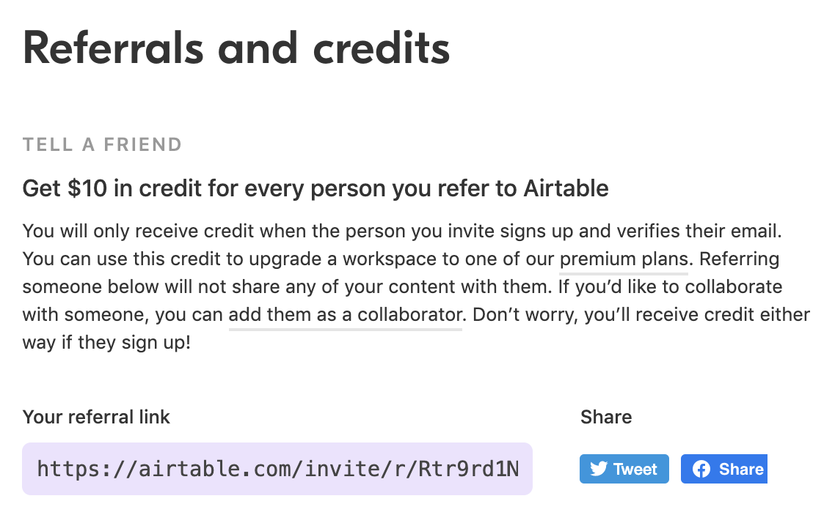
Acquisition → Conversion → Expansion
Build it Into the Product
Easy to Share
Just-In-Time Upgrading
Incentivize Invites
Branded Experiences
Notes:
Incentivize invites – again one that’s commonplace today.
Here are two example – Dropbox became famous for hockey-stick growth using this method of incentive. They offer MORE space on Dropbox for every friend you invite. So not only do their most passionate users become evangelists, they also become heavier users.
Airtable is another one that gives a dollar amount in credit for each person you invite to Airtable.

Slide 46
Acquisition → Conversion → Expansion
Build it Into the Product
Easy to Share
Just-In-Time Upgrading
Incentivize Invites
Branded Experiences
Notes:
Because companies have invested in their brand to do some work for them and are making it easy to share the product with others, they have perfect vehicles to create branded experiences for their users and for the people the users share with.
The example here is Calendly – If I send out calendar options to someone through Calendly, that Calendly experience is subtly branded.
When this experience wows someone, they ask themselves "what is this tool?" and the branding leads them to hte product

Slide 47
Acquisition → Conversion → Expansion
Expansion Key Takeaways
When the product needs to grow accounts:
Don’t make it hard for people to give you their money: Show users how they can get more value when they need or want it.
Capitalize on your value to incentivize your users to invite others.
Branded experiences are like digital word-of-mouth: a great way to allow people who value what you do to effortlessly share it with others

Slide 48
What does it mean for an organization?

Slide 49
The Old Days
Acquisition
Conversion
Expansion
Prospects
Users
Account Owners
Marketing & Sales
Customer Success
Product
Notes:
You could easily bucket people and certain departments could be responsible for certain things: Marketing & Sales could be responsible for growth of the leads and customers, Customer Success could own retention, Product was just hanging out

Slide 50
The New Days
Acquisition
Conversion
Expansion
Users
Marketing & Sales
Customer Success
Product
Notes:
Customer Success’ work may be getting involved with prospects before Sales folks touch them.
Everyone is a user at a different stage in their relationship with the product: Some are free users, some are paid users, some are enterprise team users
There’s a larger user base because everyone who wants to try it out is now a user
Goals remain the same: Move the free users along in the funnel, help them achieve outcomes, upgrade and expand

Slide 51
When the lines become blurred…
Who ”owns” the prospect when the prospect is also a user?
How do you split up communication across marketing, sales, product, and customer success so you’re not overwhelming the user?
What part does Customer Success play in moving customers from acquisition to conversion?
Notes:
I would love to hear from your perspectives, how some of these issues or questions have come into play for your companies and teams?

Slide 52
And of course, PLG isn’t right for everyone.
TABLE STAKES
Users can realize value quickly and easily
Target users can search and try solutions on their own (typically SMBs)
Your target problems are ”decentralized,” meaning a company could have multiple solutions for the same problem
SHOULD HAVE
The product has a viral network effect

Slide 53
Three key principles
Define the user base
Align across departments
Use data

Slide 54
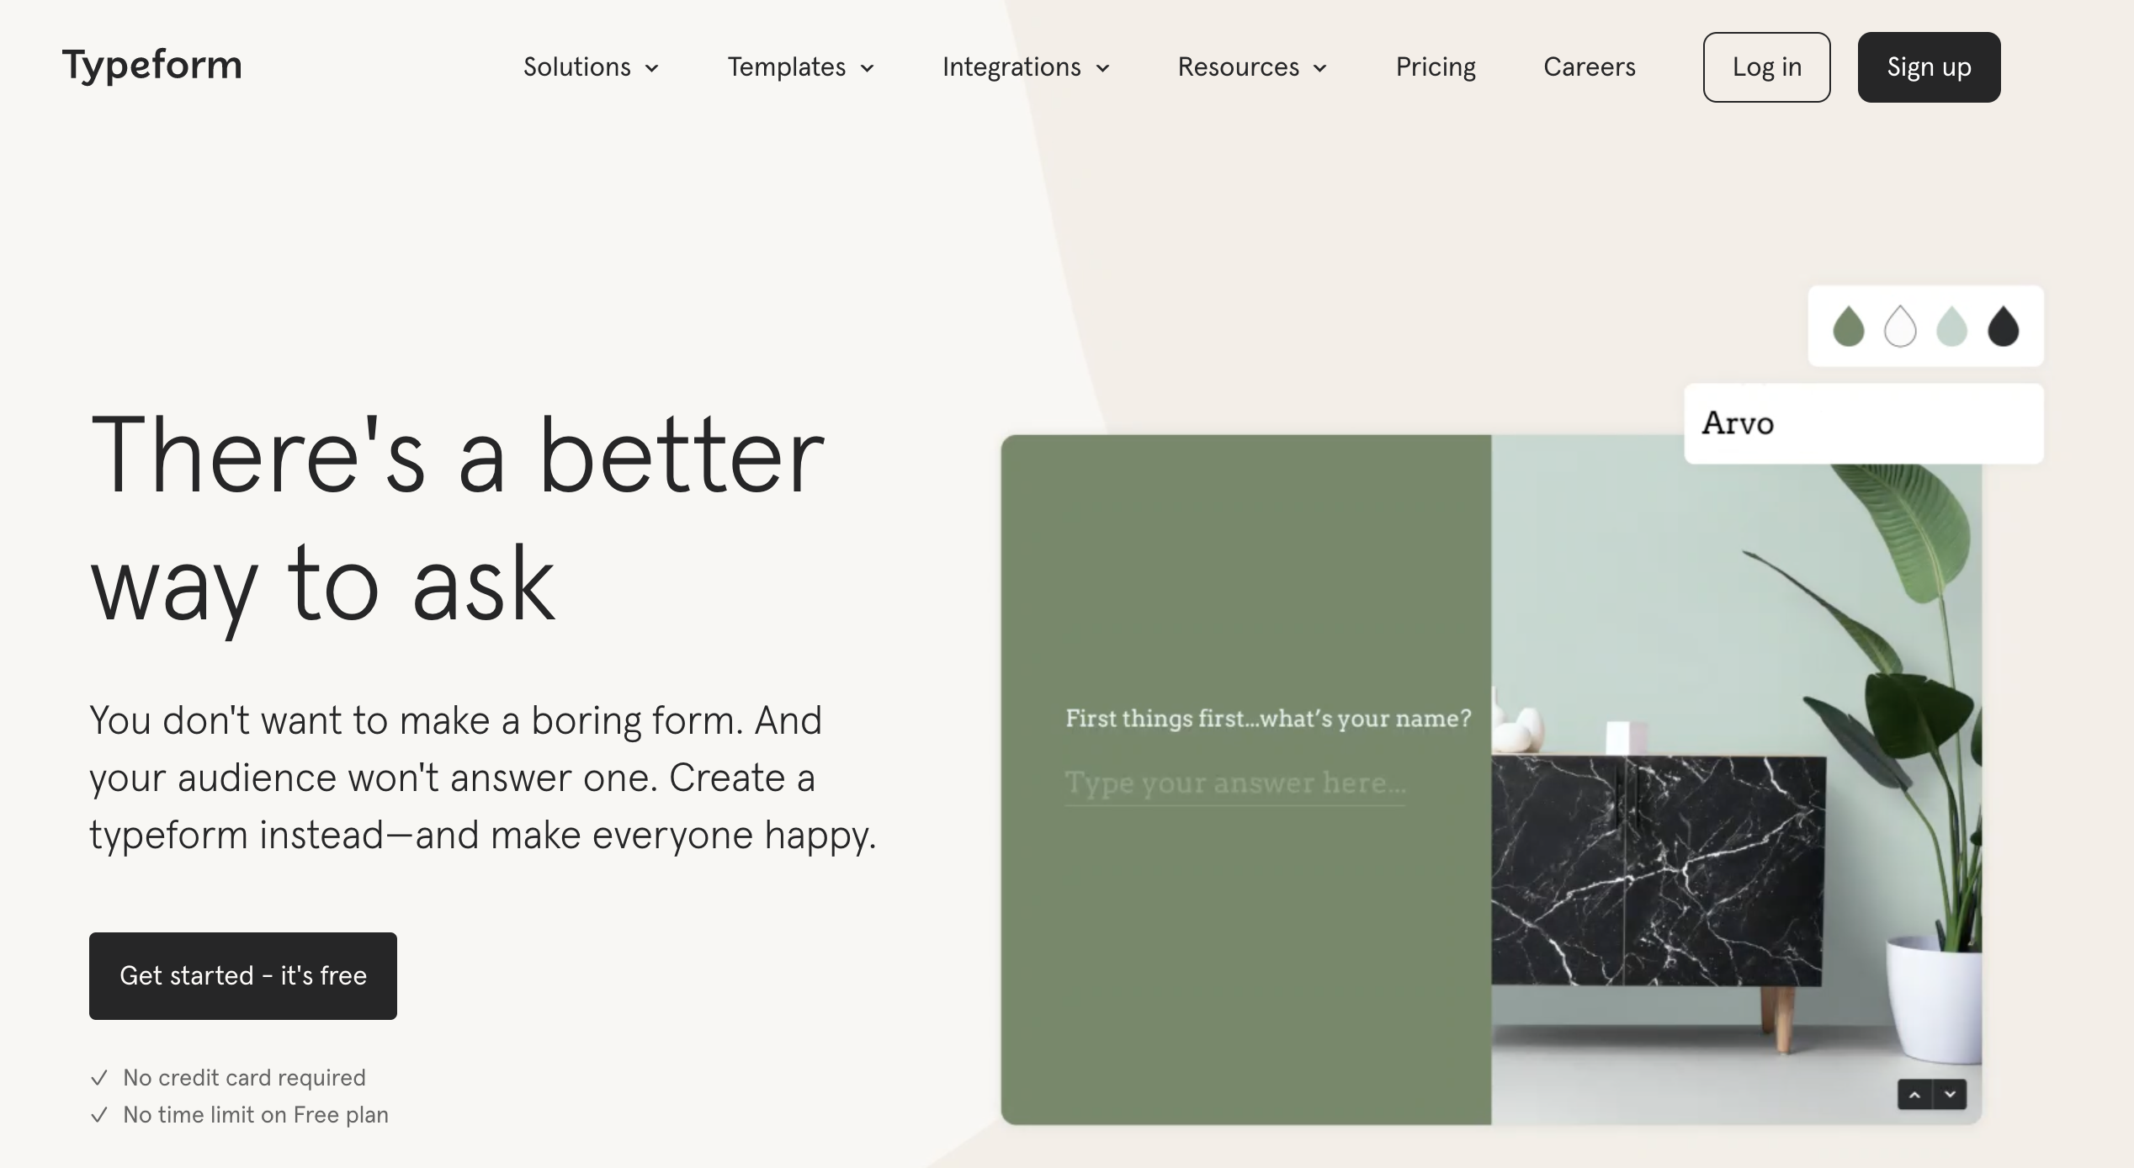
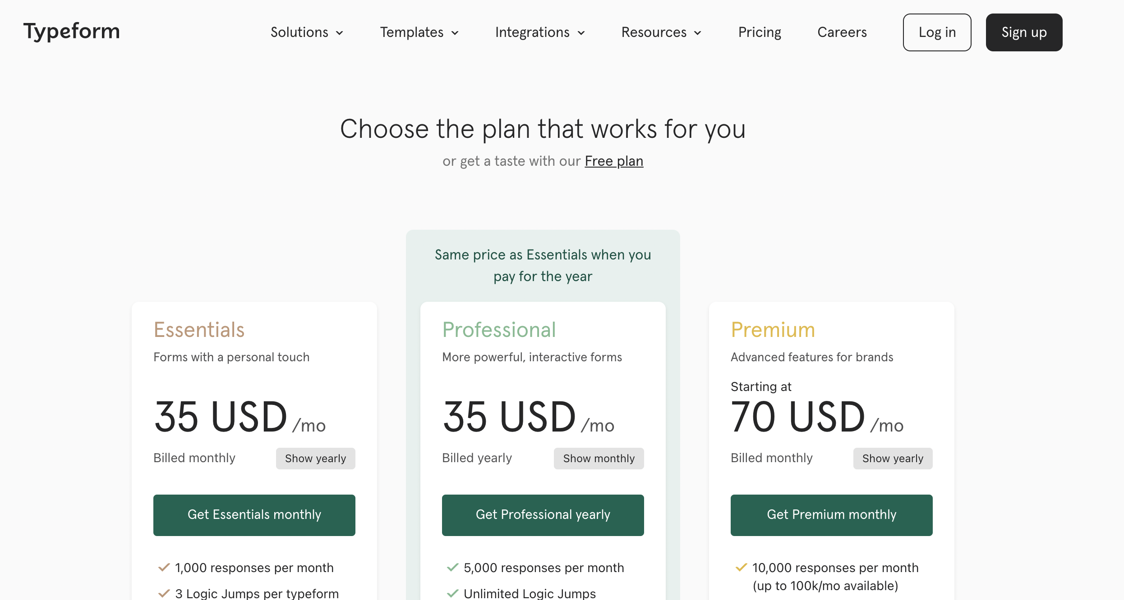
Typeform Case Study
Notes:
Have paid plans, but 90% of their users are on the free plan
I’d like to share a little bit about how David Apple, their original Customer Success leader shaped that organization.

Slide 55
Define the user base
For Typeform, this meant segmenting users into three groups:
Tech Touch
99% of user base; Automated, proactive engagement via email, in-app messaging; Focus on scalability
Just-in-Time Touch
Possible expansion candidate or re-activation; Mix of automated interactions with the option of in-person engagement for high-value activity like expansion; Focus on outcome
High Value, High Touch
Small number of high-value customers who receive personalized onboarding and regular check-ins; Focus on relationship

Slide 56
Align across departments
Align metrics across the company
For Typeform, Net Retention moved from being a Customer Success-owned metric to company-wide responsibility.
Align campaigns and communications
Typeform’s “What’s your next Typeform” campaign came from CS to help drive retention.
Publishing insights from CS data
Typeform’s CS team publishes a quarterly Customer Voice report to the rest of the company that aggregates support ticket, NPS, churn surveys, sales calls, CSM calls, chats to 1) influence product and 2) decide what to prioritize in CS

Slide 57
Use data
Identify the leading indicators as your North Star metrics, and align your team’s activities around them.
For Typeform, that meant:
Not using net retention, as it’s a lagging indicator
Using data to identify the ”sticky” features that, when used, mean customers stay: team features and integrations
Consider non-product factors: For Typeform’s CSM team, that was proper and thorough kickoffs with high-value customers

Slide 58
Tell us about PLG from your perspective.
What aspects of PLG have been implemented at your company? How has that affected Customer Success?
What have you struggled with?
What are you interested in exploring more in your department or team?
Notes:
How have you seen Customer Success become more data-driven? Doe
Some of this will be new to some of you, it may be a refresher for others, but our hope is that you leave with a better understand of what PLG is and how it impacts you.
Goals:
High-level, 101, survey
Equip with base understanding, what’s in play
Commonly used terminology

Slide 59
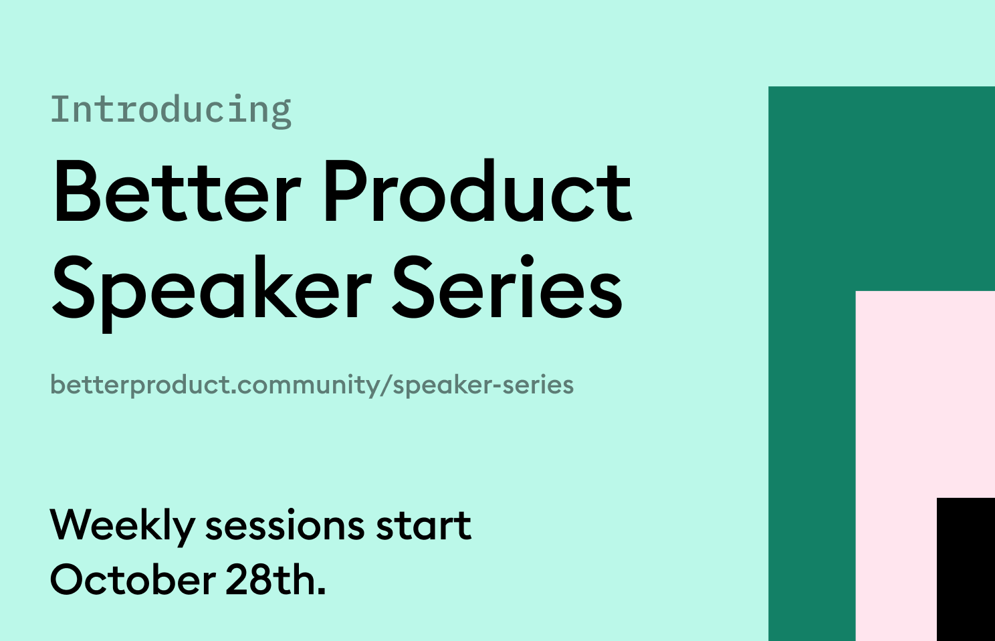

Slide 60
Define the user base
Not all users are at the same stage of using the product, and they don’t all need the same thing from Customer Success.
Some are just trying it out and they need to understand tactically how to use it to get value
Some are trying it out and they’re not the right fit
Some are believers and need help understanding how and why to expand their usage
Some are about to give up and need a reason or a reminder to stay
Some are high-value accounts that need high-touch support

Slide 61
Define the user base
Segmenting the user base and adding appropriate definition
  Typeform & Notion have done this by segmenting their customers into 3 segments:
    Tech touch customers: Typically the free users, customer success is more automated
    High-Value, High-Touch: Admins of large teams that require frequent, personal support
    Medium touch: May be largely automated with occasional personal interactions
  Processes, journeys, and key metrics must be appropriate for each segment

Slide 62
Align across departments
  Customer Success may be engaging with them before they even become paying customers – collaboration with Sales is vital. Sales and CS have to be aligned: Who owns that early-stage free customer?
  CS has access to both quantitative and qualitative data that product needs
  Sales, CS, Marketing, and Product all must be aligned on communications and channels used: If we’re all emailing the customer, we need to be sure we’re aligned on messages and campaigns and not overwhelming users

Slide 63
Use the data
  PLG relies heavily on data from the product; Where are users abandoning the product? What are the North Star metrics that tell us a customer is more likely to convert?
  CS needs to become similarly data-driven, using data from those self-service features. What help topics are people accessing most? What chat topics are people engaging in most? Where are support tickets clustering?
  Use that data to communicate back to Product as well as adjust Customer Success activities to be proactive and shape behaviors
  Also use it to generate CS campaigns and initiatives
Notes:
Using data is a core tenet of PLG: Data as a window into the minds of users – if you can’t stand over every user’s shoulder and watch what they’re doing, then you have to use the data from the product to learn about their intentions and frustrations; Where are users dropping out? If we make this design change, how does that affect conversion metrics? What North Star metrics
Typeform: Creates a quarterly Customer Voice report that aggregates support ticket, NPS, churn surveys, sales calls, CSM calls, chats to 1) influence product and 2) decide what to prioritize in CS
Typeform example around retention

Slide 64
When the Acq, Conv, Exp flywheel is going, you could potentially be talking about a lot of new users, and their success in the product may determine whether they convert or not.
Support the larger user base: Because there are a lot more of them and because their use cases are going to likely be quite small, Customer Success needs to become product-led as well
  Typeform does this by segmenting their customers into 3 segments: Tech touch customers –free, accessing CS resources through automated ways, High Value High Touch – admins of large teams, and Medium touch
  Processes, journeys, and key metrics must be appropriate for each segment
  Need to create and maintain those self-service resources
Align across departments
  Customer Success may be engaging with them before they even become paying customers
  CS has access to both quantitative and qualitative data that product needs
  Sales and CS have to be aligned: Who owns that early-stage free customer?
  Sales, CS, Marketing, and Product all have to be aligned on communications and channels used: If we’re all emailing the customer, we need to be sure we’re aligned on messages and campaigns and not overwhelming users

Slide 65
When the Acq, Conv, Exp flywheel is going, you could potentially be talking about a lot of new users, and their success in the product may determine whether they convert or not.
Data!
  PLG relies heavily on data from the product; Where are users abandoning the product? What are the North Star metrics that tell us a customer is more likely to convert?
  CS needs to become similarly data-driven, using data from those self-service features. What help topics are people accessing most? What chat topics are people engaging in most? Where are support tickets clustering?
  Use that data to communicate back to Product
  Also use it to generate CS campaigns and initiatives
    Typeform example around retention

Slide 66
What Product-Led Growth Is and Isn’t
Seamless conversion
Targeted, strategic sales activities
Marketing + product working in harmony
UX is the flour in the cake
Just freemium
Eliminating sales
Replacing traditional marketing
UX is the icing on the cake

Slide 67
Product-Led Growth Foundation:
What is PLG?
How does it work?
What does it mean for Customer Success?

Slide 68
Old days…
Acquisition
Conversion
Expansion
Prospects
Users
Contract-Signers
Marketing and sales
Goal is to move them further along the funnel and convert them
Customer Success
Keep them achieving outcomes
Retention
Sales
Goal is to keep the accounts and upgrade/expand them

Slide 69
The New Days
Acquisition
Conversion
Expansion
Users
Everyone is a user at a different stage in their relationship with the product
There’s a larger user base because everyone who wants to try it out is now a user
Goals remain the same: Move the free users along in the funnel, help them achieve outcomes, upgrade and expand

Slide 70


The Old Days
Acquisition
Conversion
Expansion
Sales team interacting with highest level at a company
Top-down decisions by C-suite
Marketing targeted
high-level buyers
Long-term contracts
Static training, documentation
Expensive, difficult implementation
Sales-led upsells
Extensive customizations
Lengthy upgrade processes
Sales -> C-Suite
IT Department
Sales -> C-Suite
Notes:
”Software” was the realm of IT, and they were the gatekeepers for solving problems
Delivery meant software on-premise, disks
Expensive to build, expensive to implement, expensive to train, expensive to maintain, expensive to upgrade
Major investment for companies, decisions have to be made at the top
Downstream effects -> Some things just don’t matter as much in this model: Brand doesn’t need to be interesting or engaging, User Experience is an afterthought, Marketing focused on top echelons, Support is focused on problems and being more reactive

Slide 71
The New Days
Acquisition
Conversion
Expansion
End-users experiencing a problem Google it, find a solution, try it out on their own
If they are convinced there’s value, the end user can pay for a low-tier package
To get more value, the end user can invite others, upgrade to unlock more features and allow for more users
End User
IT, governance, larger budget packages

Slide 72

The New Days
Acquisition
Conversion
Expansion
End-users experiencing a problem Google it, find a solution, try it out on their own
If they are convinced there’s value, the end user can pay for a low-tier package
To get more value, the end user can invite others, upgrade to unlock more features and allow for more users
End User
End User
End User
Notes:
What are the downstream effects?
Brand has to appeal to a wider audience and has to draw the end user in (the difference between Microsoft’s brand and Slack’s brand)
Marketing has to speak to practical problem-solving value
You can’t possibly have a sales team big enough to cover every end user, and besides that each end user by themselves is very small value, so how do you sell then? By making some part of the product free all the time or free for a short time so they can get in and try it for themselves
Product must be intuitive, easy to learn and easy to obtain value or users will quit, so product experience and design becomes vital

